Slide 1

Autonomous and mobile robot for hydroponic greenhouse picking tasks
Candidate
Federico Rollo
ID number 1851121
Thesis Advisor
Prof. Giuseppe Oriolo

Slide 2
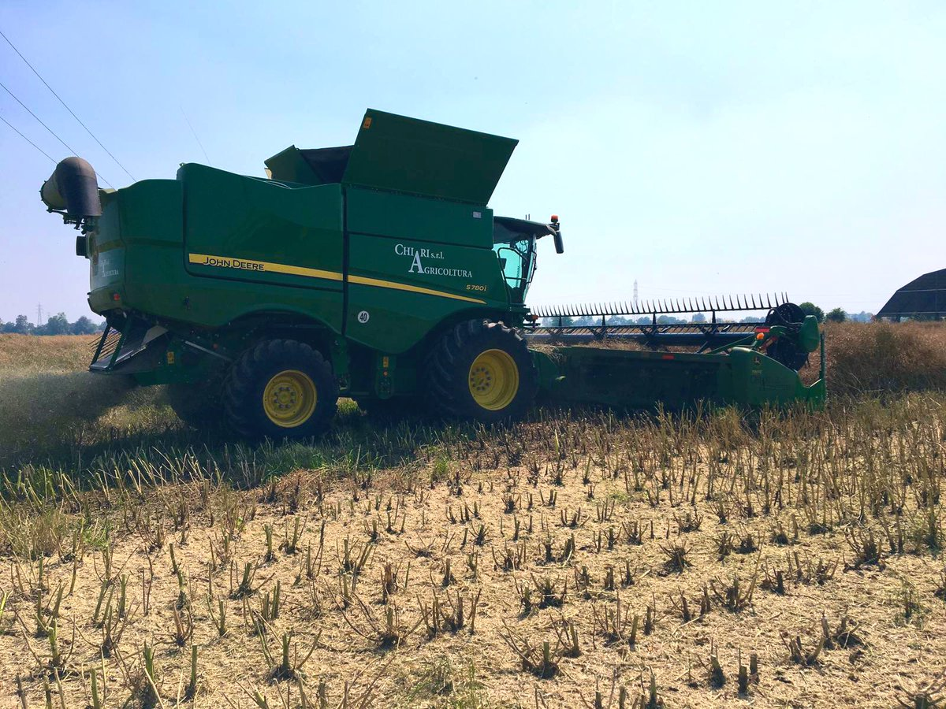
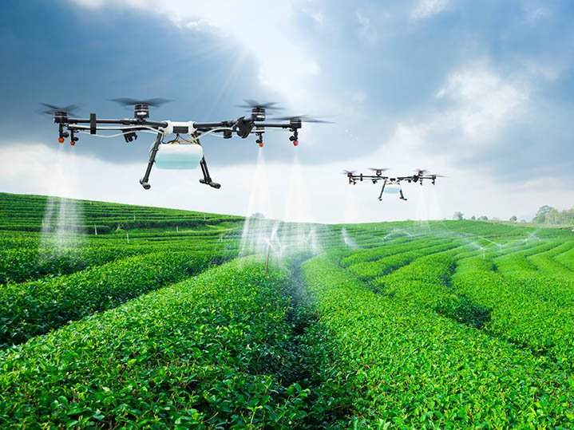
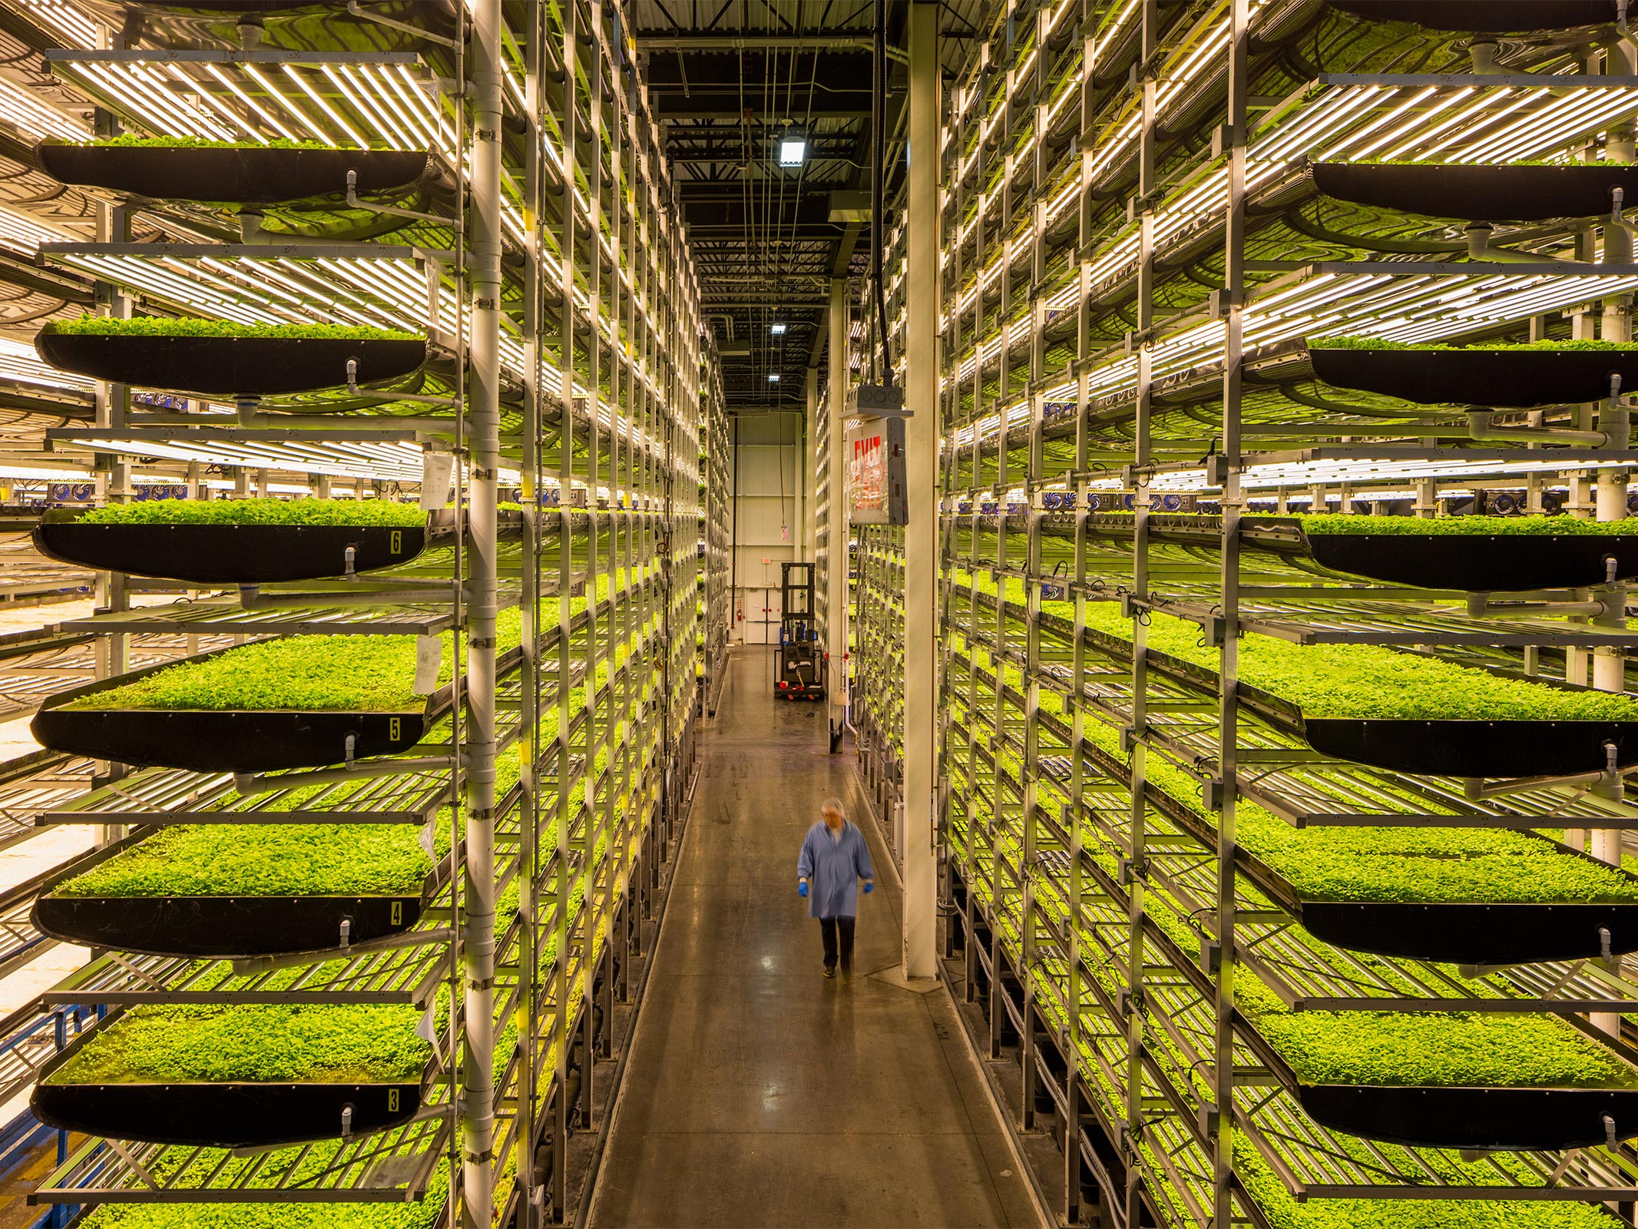
Introduction
Agriculture 4.0:
new technologies
the necessity of more products in a minor time.
Different solutions presented during these years to overcome population growth.
Use of robots to perform hard labor in less time with more productivity

Slide 3


Case of study
Development of a zucchini flower picking robot for the SolarFields hydroponic greenhouses.
SolarFields company is a clean energy productor which is investing in hydroponic greenhouse start-ups like Idroluppolo
These companies are working together to find healthy solution to provide fresh and biological fruits on the market
Robotics and automation aims to make the production processes fully autonomous

Slide 4
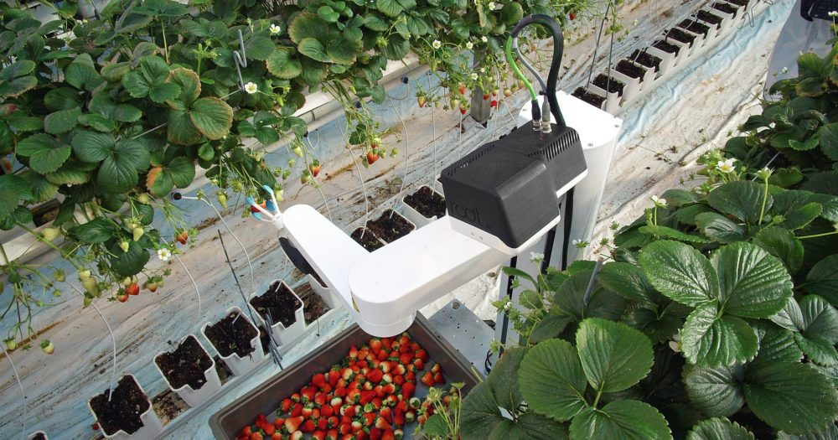
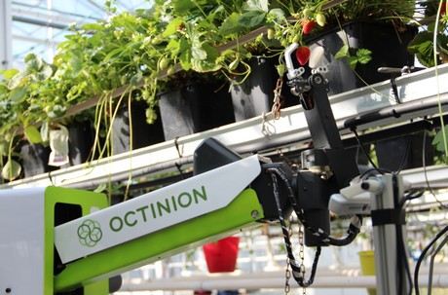
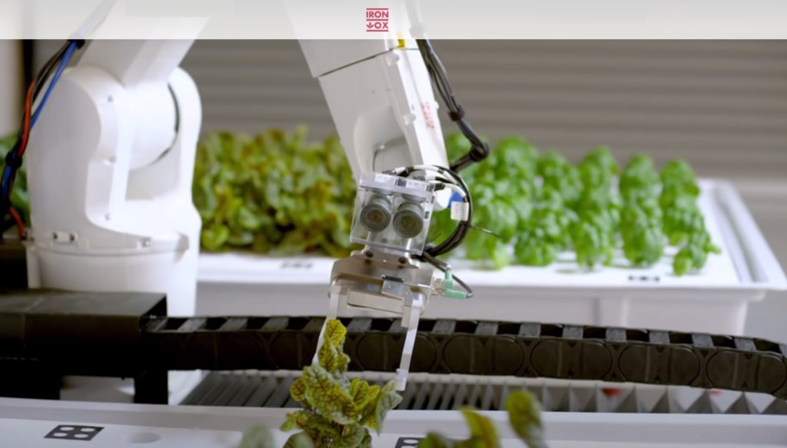
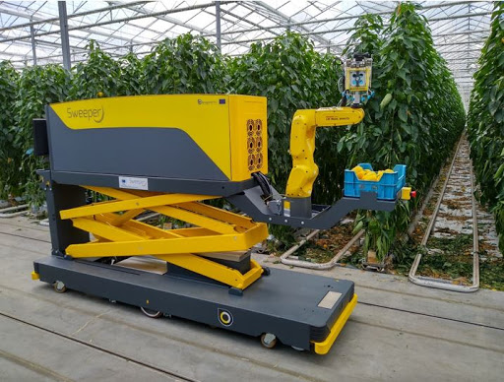
Existing robots
Root AI
Rubion
Iron Ox
Sweeper Robot

Slide 5
Project specifications
The robot is composed of three main parts:
Mobile platform
Robotic arm
Vision system
The aim of the robot is to move inside the greenhouse and pick the zucchini flowers on the plants
The following work is divided in two main parts:
Feasibility study and design of algorithm and robot structure
Simulation and control of the robot to prove the project feasibility

Slide 6
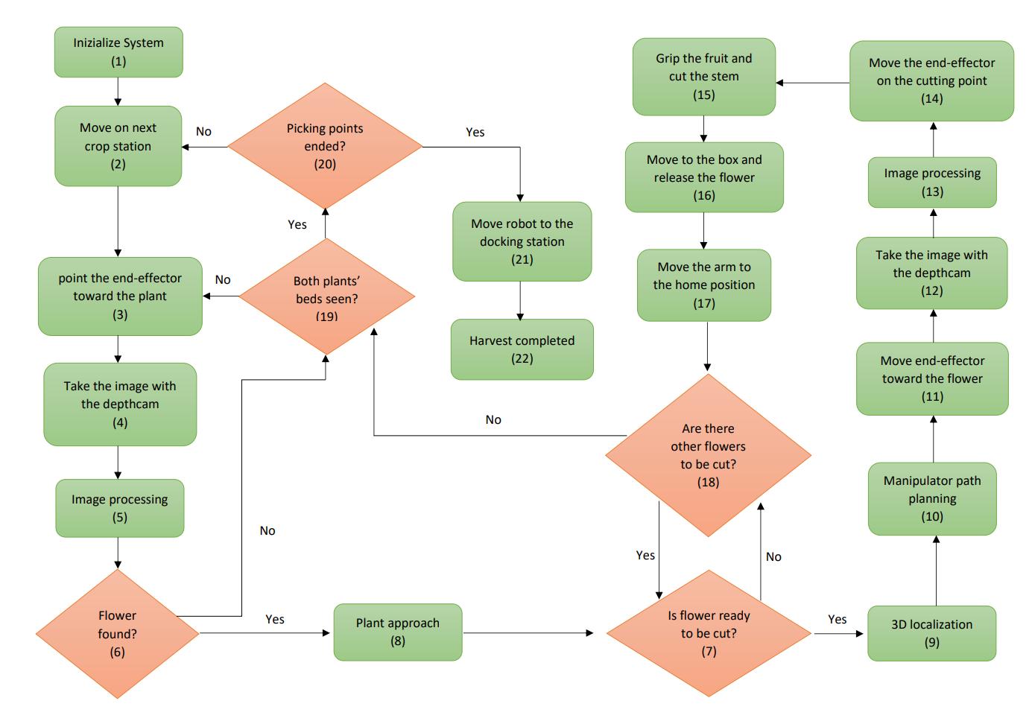
Algorithm

Slide 7
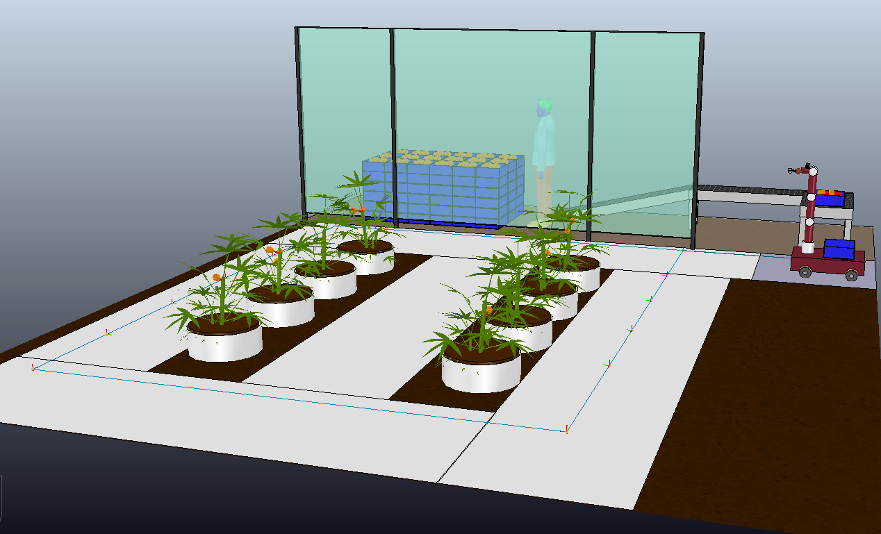
Greenhouse environment

Slide 8
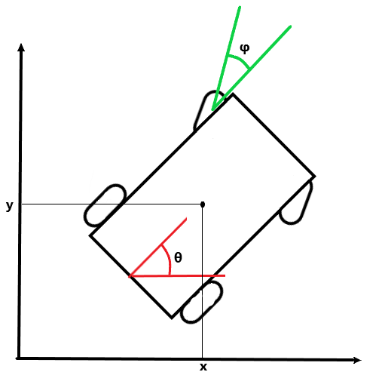
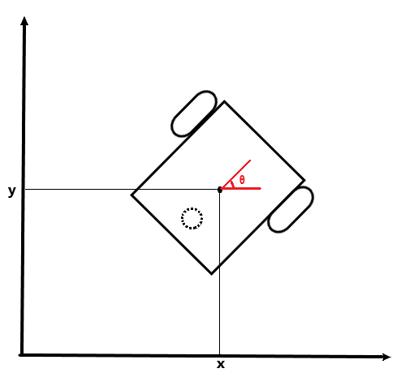
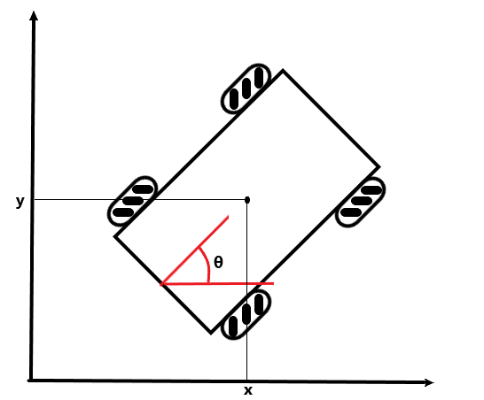
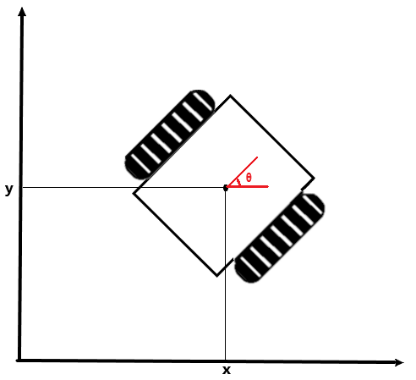
Mobile Platform
Three different mobile platforms have been considered:
Car-like robot
Differential drive robot
Mecanum wheels robot

Slide 9
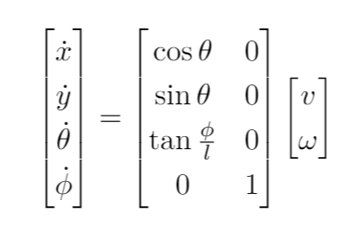
Car-like robot
Pro
Good stability
Good traction force
Cons
Difficult to control in narrow passages
Necessity of maneuvers
Car-like robot
Front wheel drive kinematic model

Slide 10
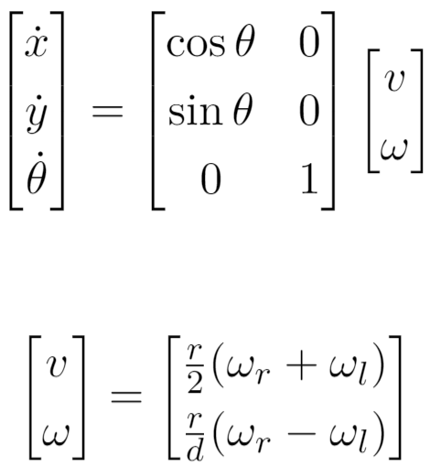
Differential drive robot
First configuration → two actuated wheels and an omnidirectional wheel
Pro
Simple model
Good controllability
Cons
Bad stability due to manipulator arm attached on
Unicycle model
Differential drive robot
Differential drive input transformation

Slide 11

Differential drive robot
Second configuration → two actuated crawler
Pro
Simple model
Good controllability
Good stability
Good traction
Cons
Expensive
Unicycle model
Differential drive robot
Differential drive input transformation

Slide 12
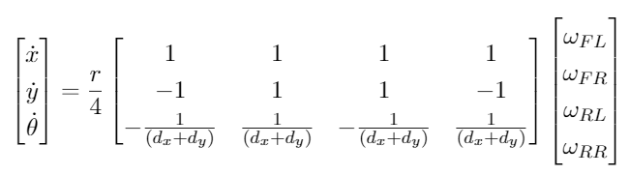
Mecanum wheel robot
Pro
Omni-directionality
Good controllability
Good stability
Cons
Bad traction on rough terrain
Mecanum wheels robot
Mecanum wheel robot kinematic model

Slide 13
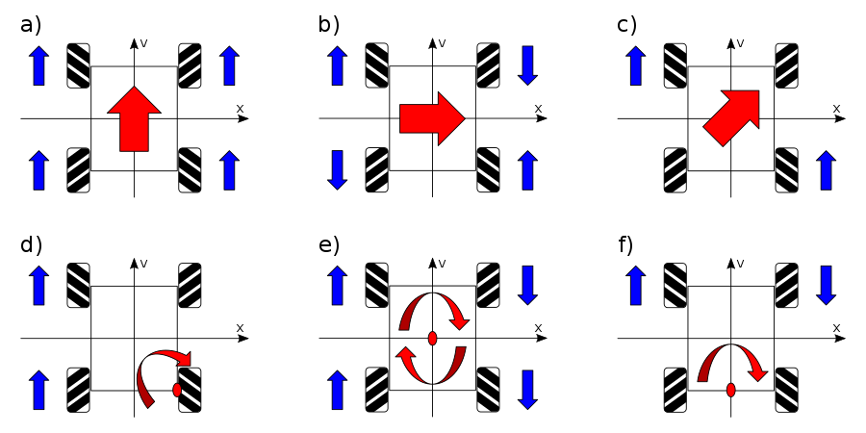
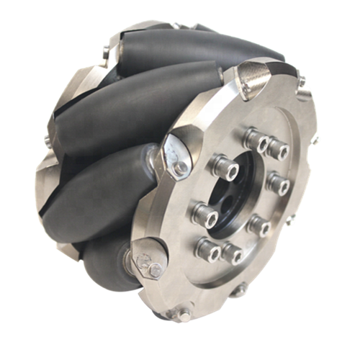
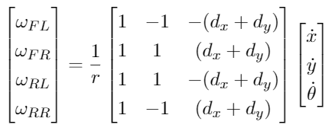
Mecanum wheel robot
Omni-directionality
Mecanum wheel
Inverse kinematic model

Slide 14
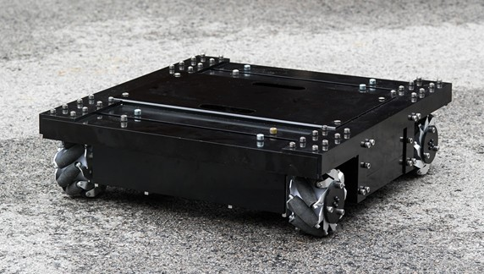
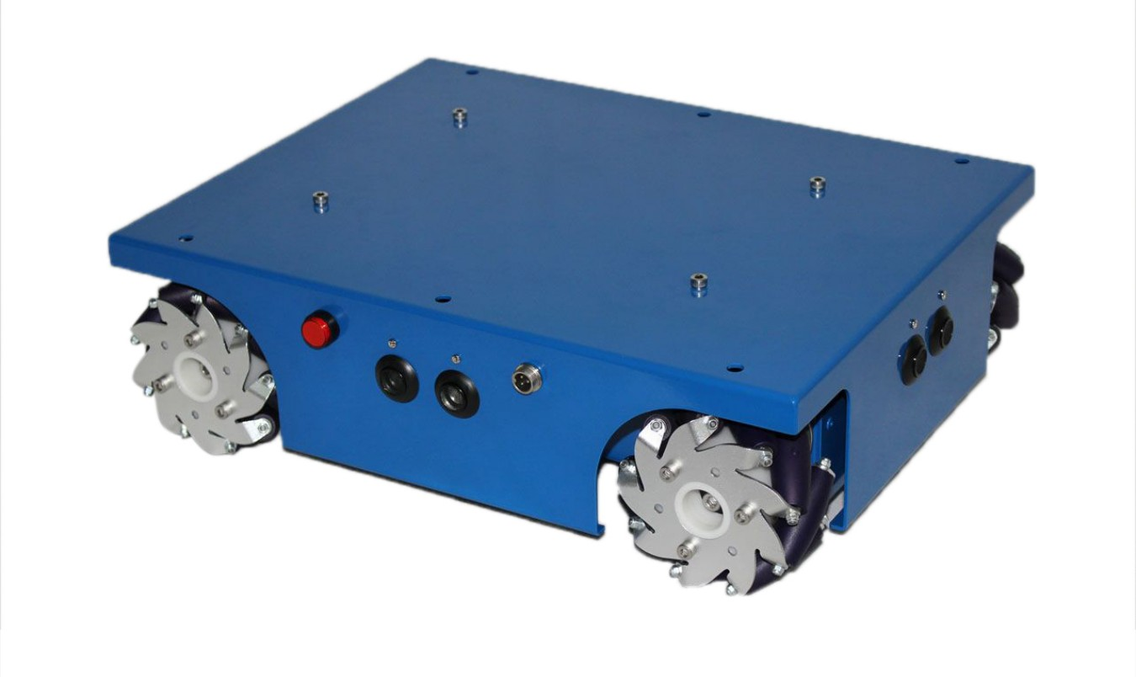
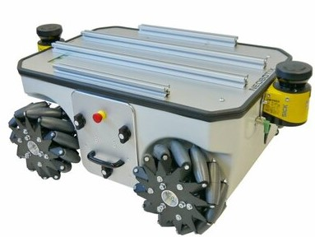
Mobile platform prototypes
OMR10
4WD mecanum
MP-500
Dimensions(mm):
480 x 450 x 134
Load capacity:
20kg
Max speed:
0.6m/s
Battery life:
8h
Charging time:
4h
Dimensions(mm):
400 x 307 x 123
Load capacity:
10kg
Max speed:
0.6m/s
Battery life:
6h
Charging time:
4h
Sensors:
4 ultrasonic
Dimensions(mm):
986 x 662 x 409
Load capacity:
80kg
Max speed:
0.8m/s
Battery life:
7h
Charging time:
5h
Sensors:
2 lidar - 4 ultrasonic

Slide 15
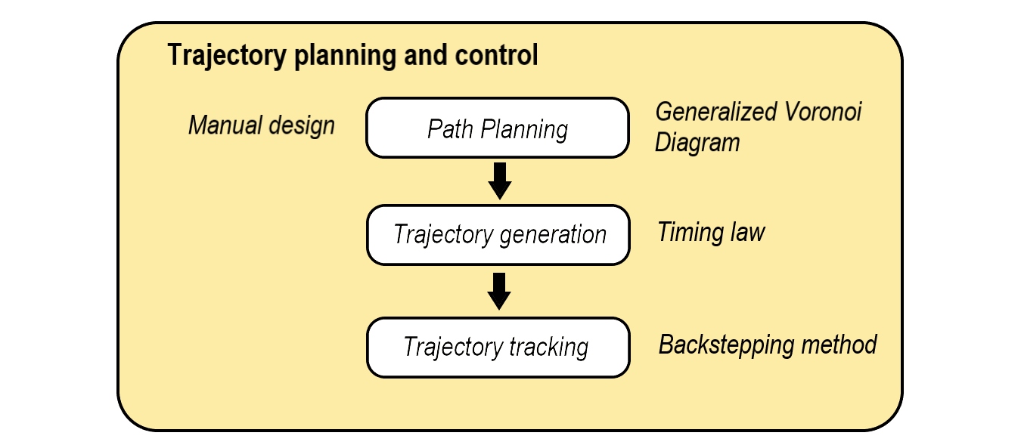
Trajectory planning and control

Slide 16
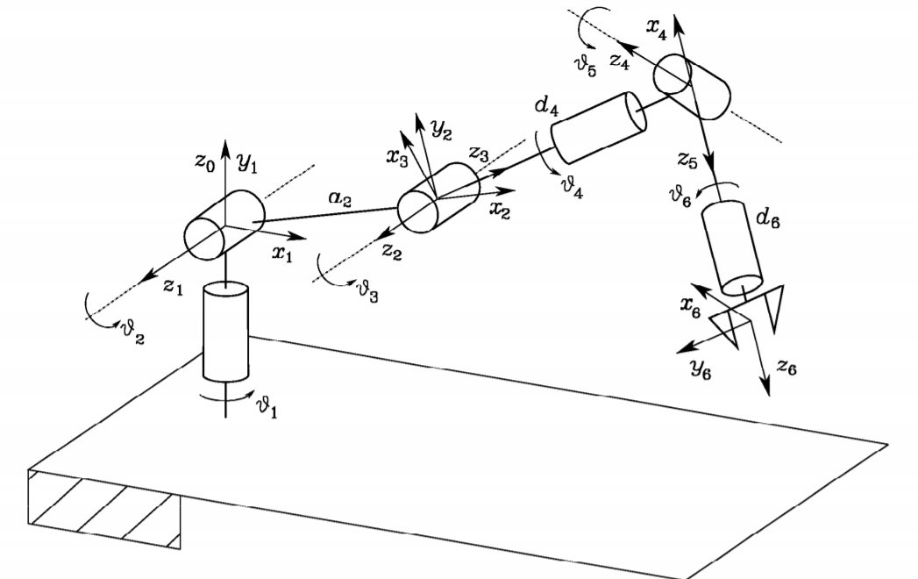
6 DOF robotic arm
6 DOF robotic arm
6 DOF robotic arm has been proven to be enough for the picking task
The forward and inverse kinematics have been computed for simulation purposes using Denavit-Hartemberg convention
The differential kinematics has been derived by the forward kinematics and it has been used for the robot control

Slide 17
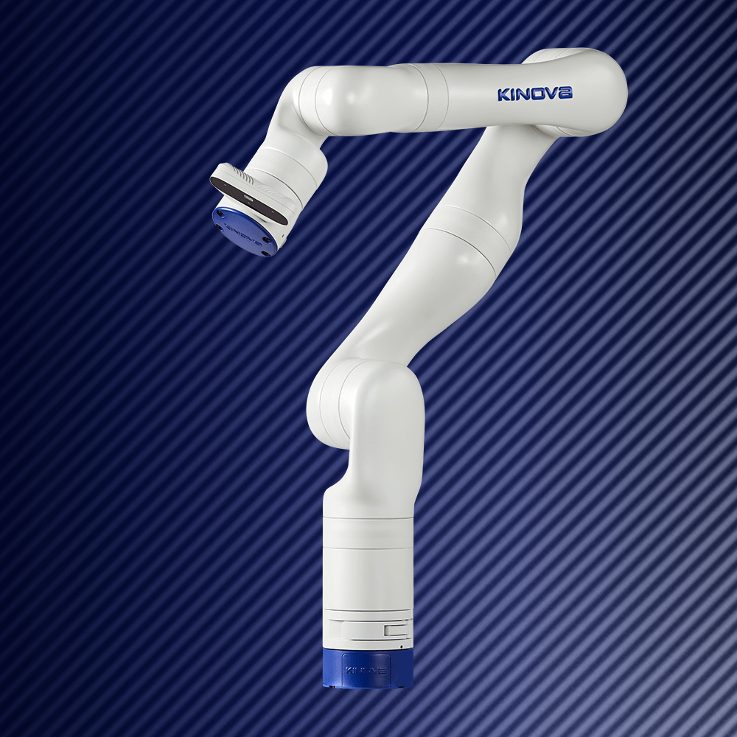
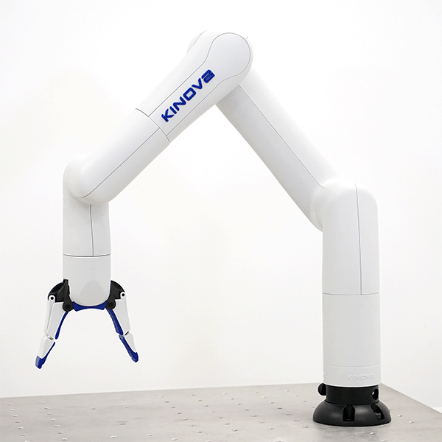
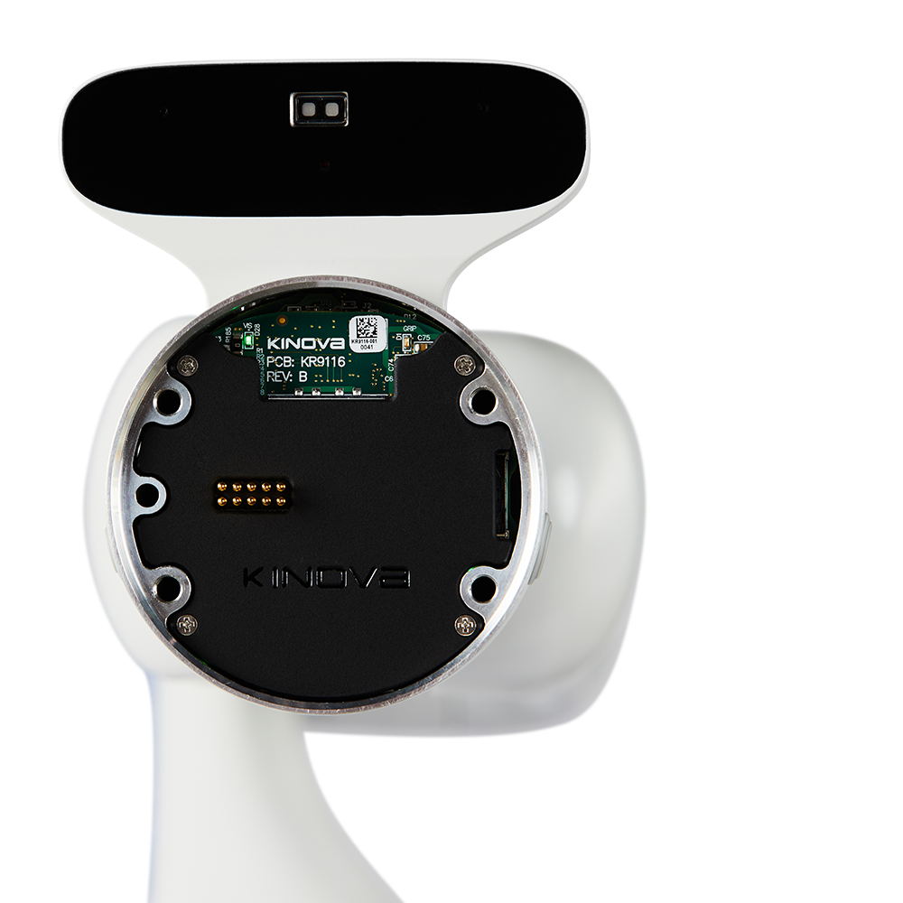
6 DOF Manipulator arm prototypes
Gen3
Gen3 Light
Kinova RGB-D
Payload:
0.5kg
Max e-e speed:
50 cm/s
Max reach:
706mm
Weight:
5.4kg
Payload:
2kg
Max e-e speed:
50 cm/s
Max reach:
891mm
Weight:
7.2kg
RGB sensor:
Resolution: 1980x1080 at 30fps
Depth sensor
Resolution:
480x270 at 30fps
Min distance: 18cm

Slide 18
Vision System
One of the fundamental modules for the picking task.
RGB-D camera chosen based on the ToF technology
Recognition, identification and localization of the flowers inside the environment.
Two objectives:
Flower recognition
Flower separation and localization
Two algorithm have been developed to accomplish these tasks:
K-mean algorithm for color clustering
Moore-Neighbor tracing algorithm modified by Jacob's stopping criteria for flower separation

Slide 19
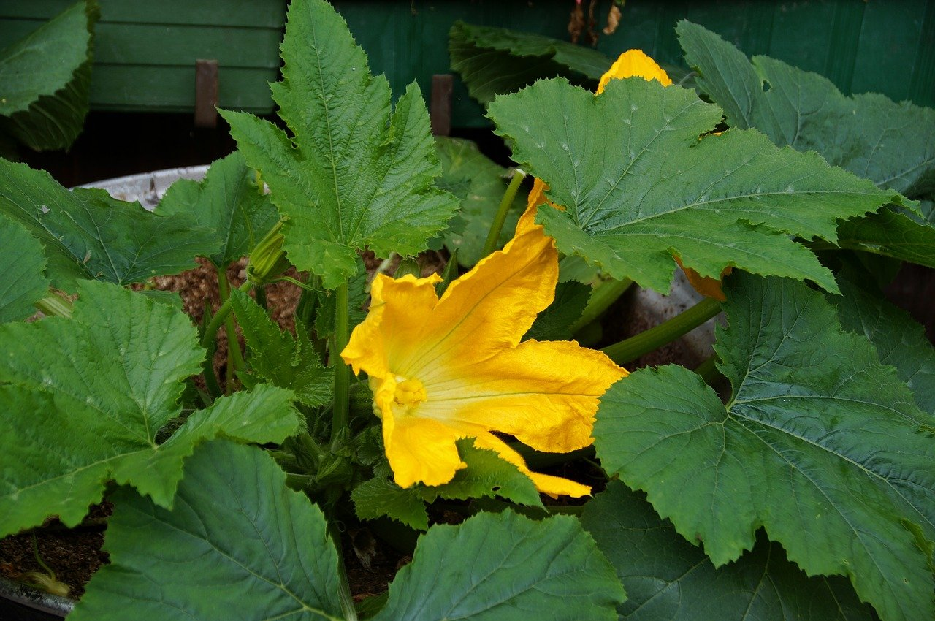
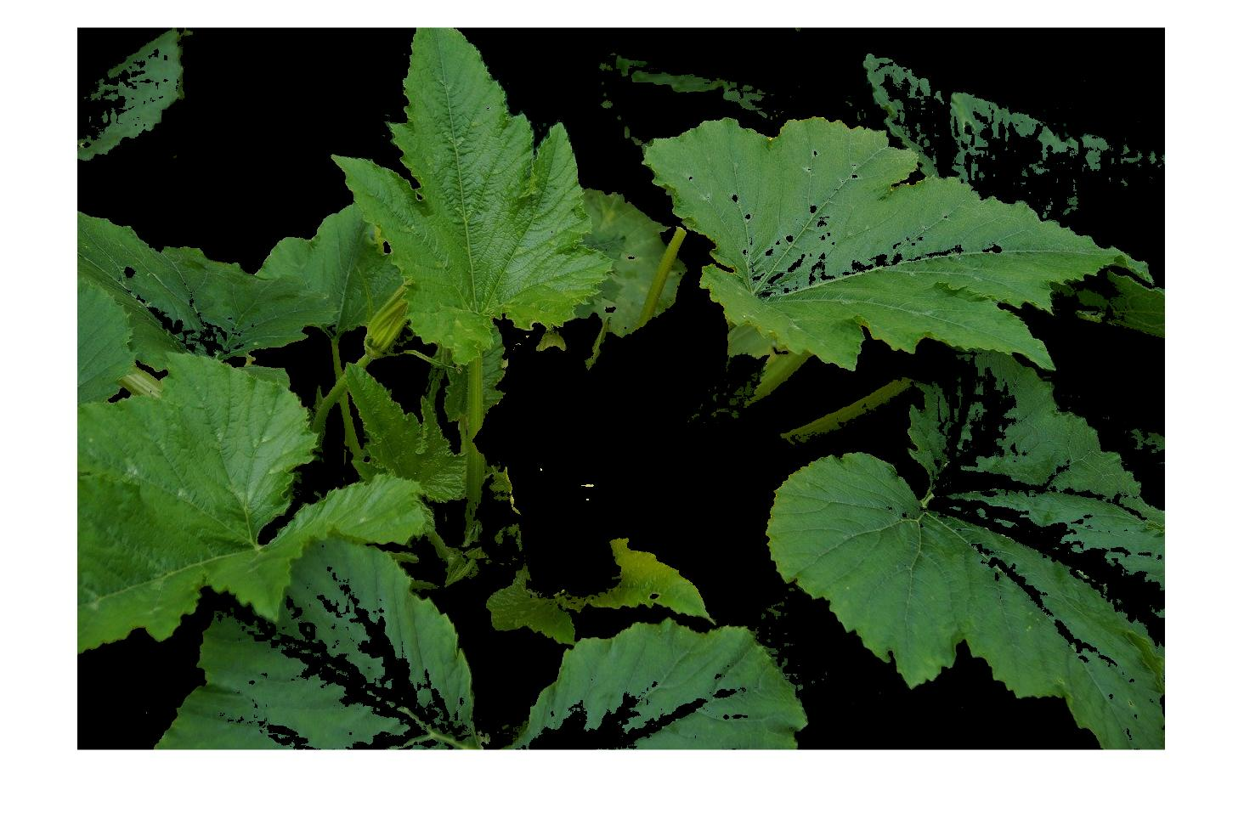
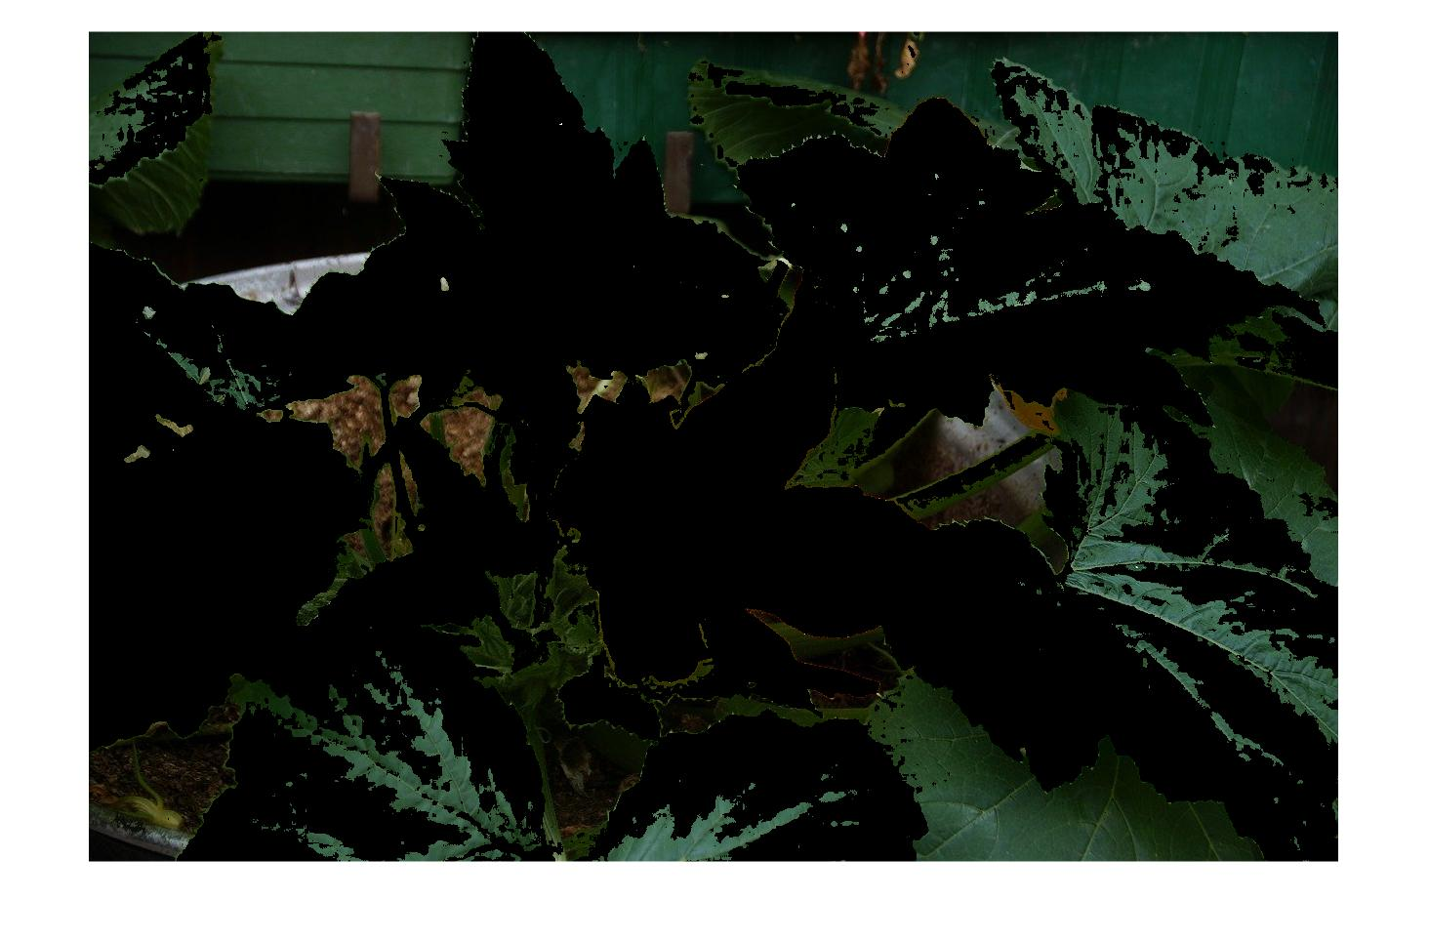
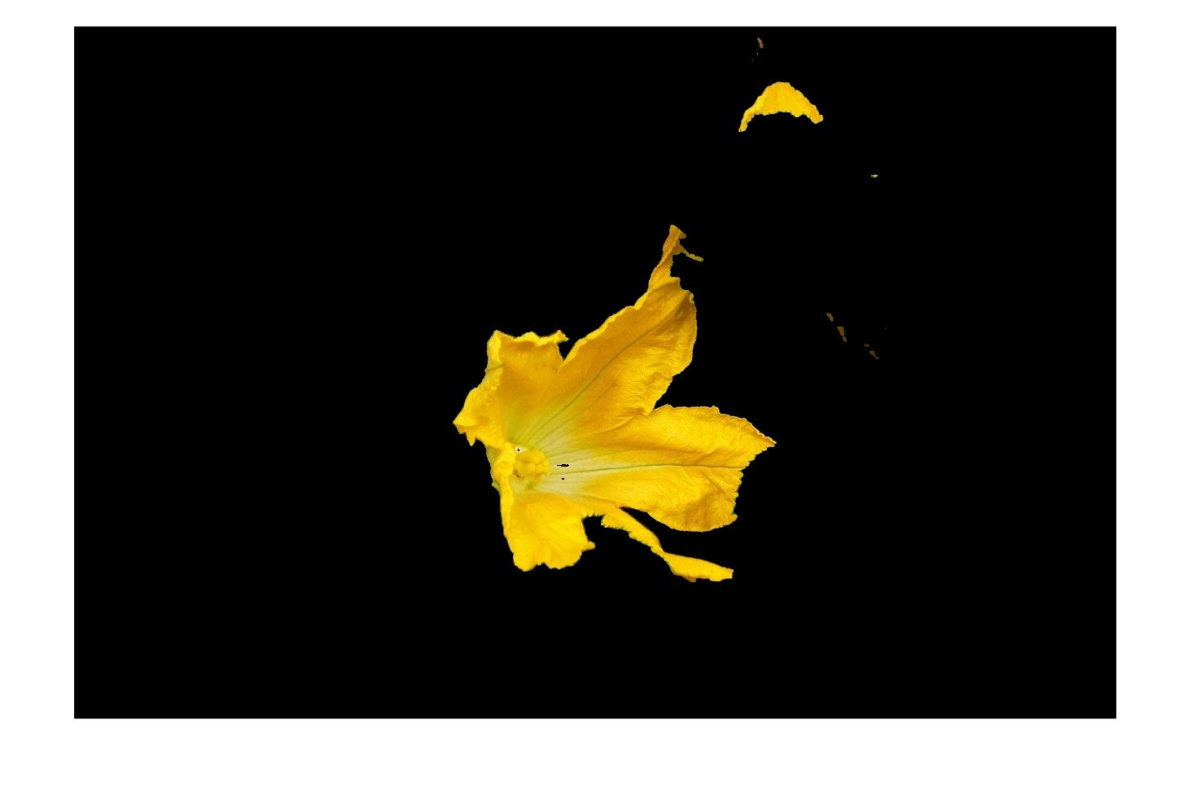
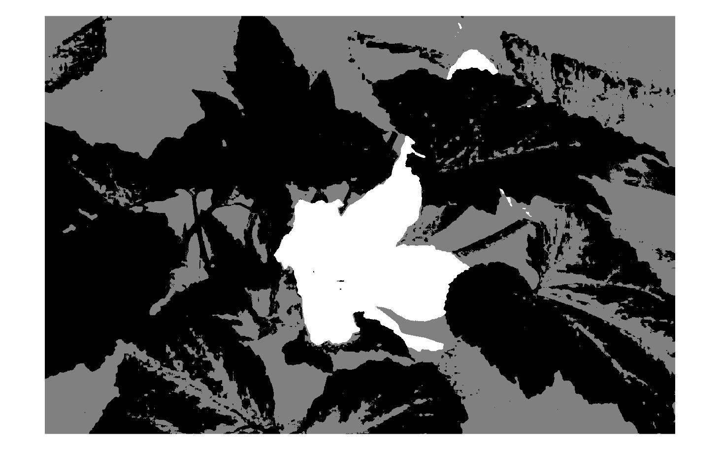
Flower identification
Original image
First cluster
Second cluster
Labeled image
Third cluster

Slide 20
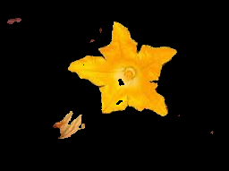
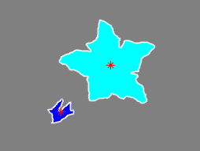
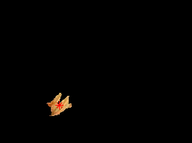

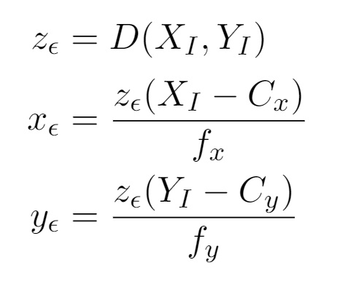
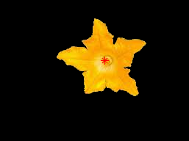
Flower separation and localization
Flower cluster
Labeled image
First flower
Flower 3D localization
Binarization, noise attenuation and hole filling
Second flower

Slide 21
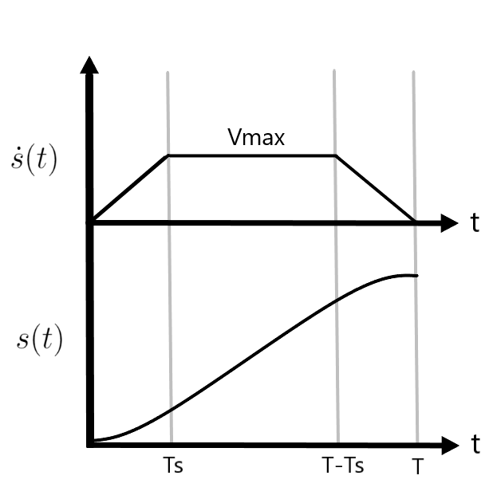
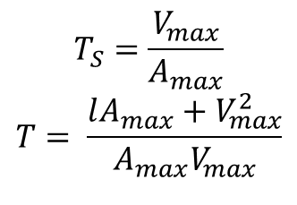
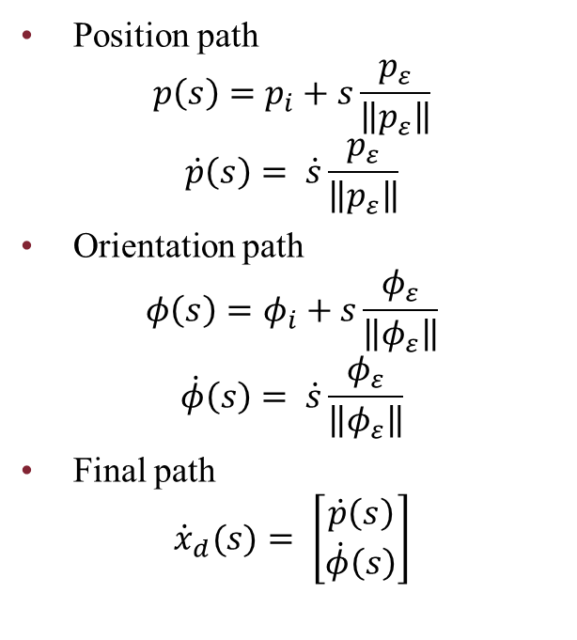
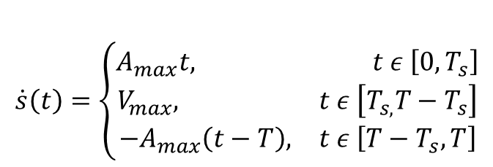
Trajectory generation
Path planning
Timing law
Position path
$$p\left(s\right)=p_{i}+s\frac{p_{ε}}{\left\|p_{ε}\right\|}$$
$$\dot{p}\left(s\right)= \dot{s}\frac{p_{ε}}{\left\|p_{ε}\right\|}$$
Orientation path
$$φ\left(s\right)=φ_{i}+s\frac{φ_{ε}}{\left\|φ_{ε}\right\|}$$
$$\dot{φ}\left(s\right)= \dot{s}\frac{φ_{ε}}{\left\|φ_{ε}\right\|}$$
Final path
$${\dot{x}}_{d}(s)= \left[\begin{matrix}\dot{p}\left(s\right) \\ \dot{φ}\left(s\right)\end{matrix}\right]$$
$$T_{S}=\frac{V_{max}}{A_{max}}$$
$$T= \frac{lA_{max}+V_{max}^{2}}{A_{max}V_{max}}$$
$$\dot{s}\left(t\right)=\left\{\begin{aligned}A_{max}t, t ε \left[0,T_{s}\right] \\ &V_{max}, t ε \left[T_{s,}T−T_{s}\right] \\ \begin{matrix}−A_{max}\left(t−T\right), & t ε \left[T−T_{s},T\right]\end{matrix}\end{aligned}\right.$$

Slide 22
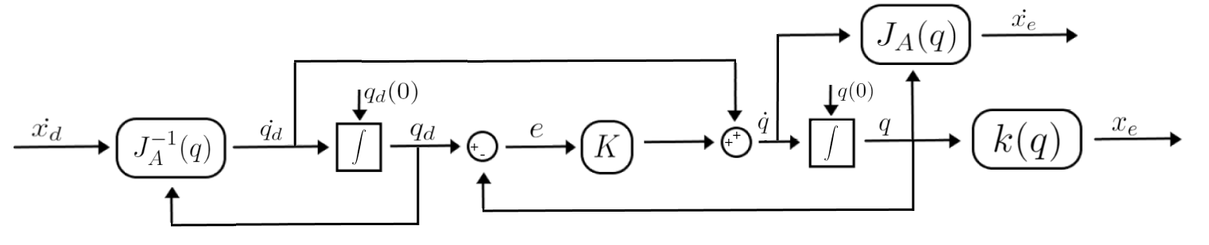
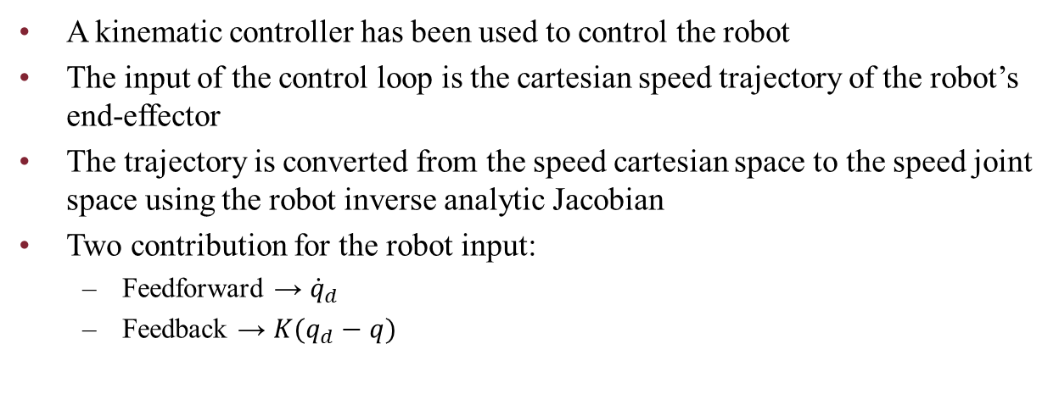
Robotic arm kinematic control
A kinematic controller has been used to control the robot
The input of the control loop is the cartesian speed trajectory of the robot’s end-effector
The trajectory is converted from the speed cartesian space to the speed joint space using the robot inverse analytic Jacobian
Two contribution for the robot input:
Feedforward → ${\dot{q}}_{d}$
Feedback → $K(q_{d}−q)$

Slide 23
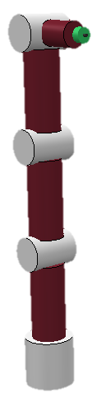
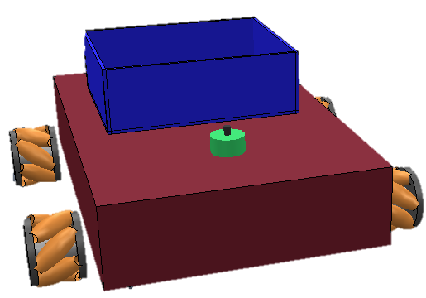
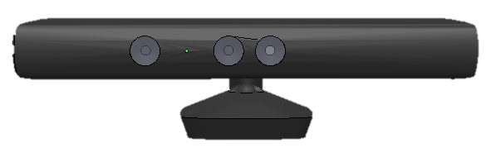
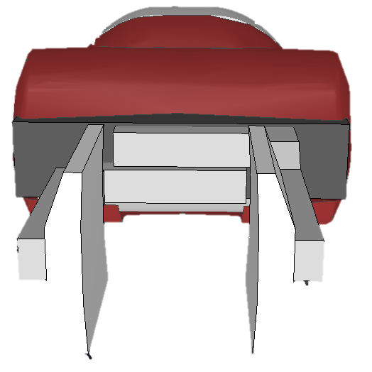
Simulation
Tools
Matlab
Vrep
The robot mobile platform and its 6 DOF manipulator arm have been developed on Vrep using joints and primitive shapes

Slide 24
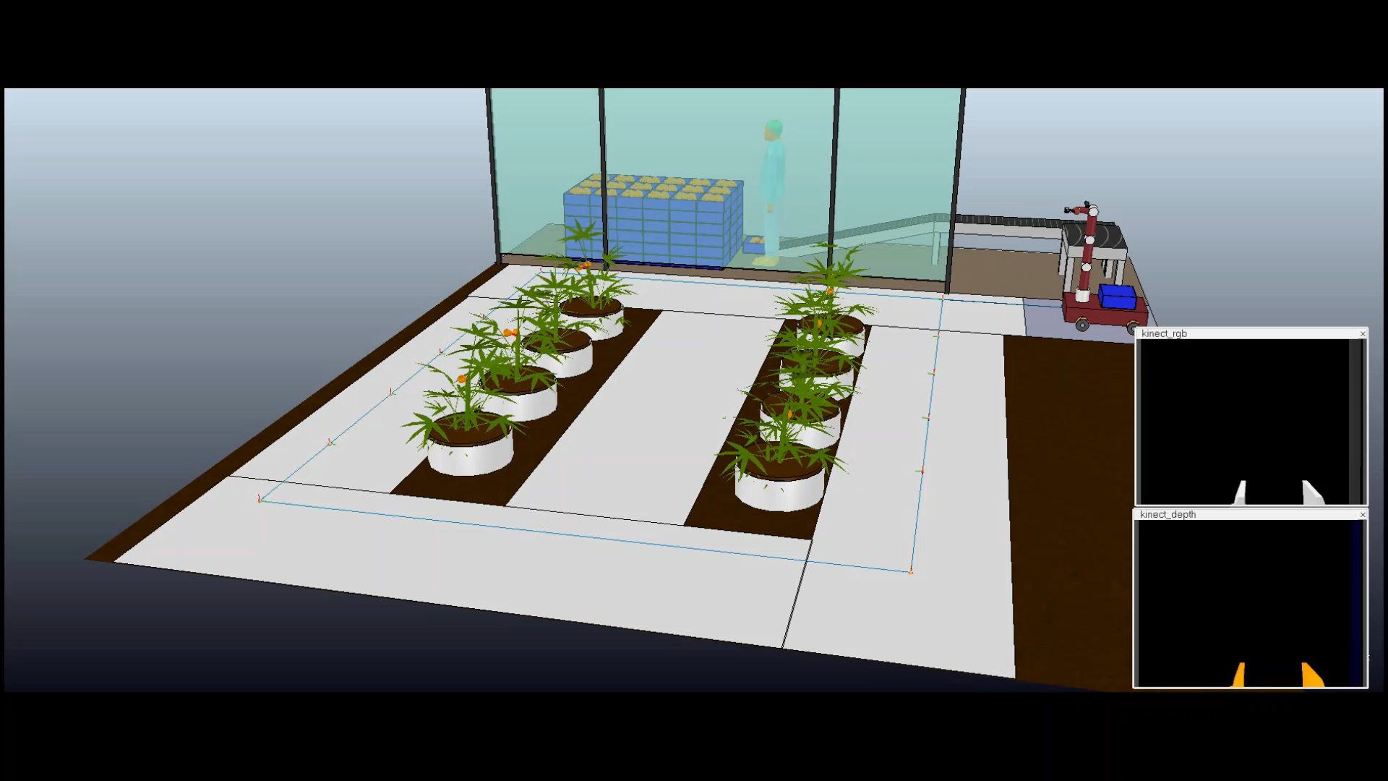
Simulation

Slide 25
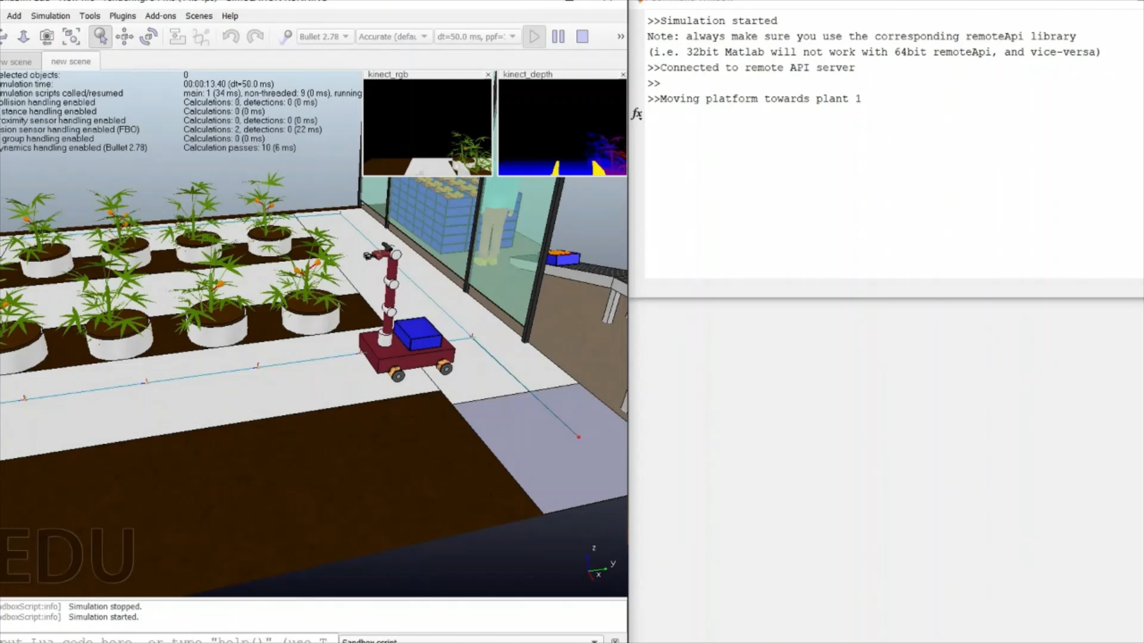
Simulation

Slide 26
Conclusion
Although the project has been simplified, the simulation had proven that the algorithms and the structure used works. This project could be applied to a real application scenario in an agriculture 4.0 hydroponic greenhouse.
Future improvements:
Implement a localization systems
Improve the machine learning algorithms
Use multiple robots - distributed systems
Use a more sophisticated robot controller
Others

